Slide 1


1
Introduction to Computing and Programming
C# Programming: From Problem Analysis to Program Design
4th Edition

Slide 2
Chapter Objectives
Learn about the history of computers
Learn to differentiate between system and application software
Learn the steps of software development
Explore different programming methodologies
Learn why C# is being used today for software development

Slide 3
Chapter Objectives (continued)
Distinguish between the different types of applications
Explore a program written in C#
Examine the basic elements of a C# program
Compile, run, build, and debug an application
Create an application that displays output
Work through a programming example that illustrates the chapter’s concepts

Slide 4
History of Computers
Computing dates back 5,000 years
Currently in fourth or fifth generation of modern computing
Pre-modern computing
Abacus
Pascaline (1642)
Analytical Engine (1830 – Charles Babbage & Lady Lovelace)

Slide 5
History of Computers (continued)
First generation distinguished by use of vacuum tubes (mid-1940s)
Second generation distinguished by use of transistors (mid-1950s)
Software industry born (COBOL, Fortran)
Third generation – transistors squeezed onto small silicon discs (1964-1971)
Computers became smaller
Operating systems first seen

Slide 6
History of Computers (continued)
Fourth generation – computer manufacturers brought computing to general consumers
Introduction of IBM personal computer (PC) and clones (1981)
Fifth generation – more difficult to define
Computers accept spoken word instructions
Computers imitate human reasoning through AI
Computers communicate globally
Mobile and wireless applications are growing

Slide 7

System and Application Software
Software consists of programs
Sets of instructions telling the computer exactly what to do
Two types of software
System
Application
Power of what the computer does lies with what types of software are available

Slide 8
System Software
System software is more than operating systems
Operating System
Loaded when you power on the computer
Examples include Windows 8, Linux, Android, iOS
Includes file system utilities, communication software
Includes compilers, interpreters, and assemblers

Slide 9
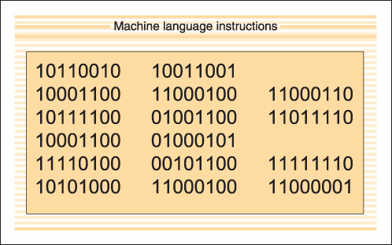
Software (continued)
Figure 1-1 A machine language instruction

Slide 10
Application Software
Application software performs a specific task
Word processors, spreadsheets, payroll, inventory
Writes instructions using a high-level programming language
C#, Java, Visual Basic
Compiler
Translates instructions into machine-readable form
First checks for rule violations
Syntax rules – how to write statements

Slide 11
Software Development Process
Programming is a process of problem solving
How do you start?
Number of different approaches, or methodologies
Successful problem solvers follow a methodical approach

Slide 12
Steps in the Program Development Process
1. Analyze the problem
2. Design a solution
3. Code the solution
4. Implement the code
5. Test and debug

Slide 13
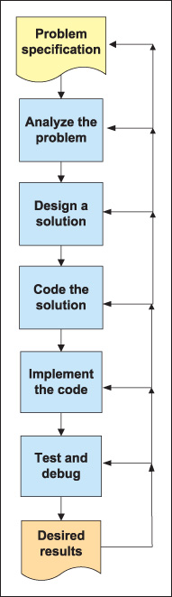
Steps in the Program Development Process (continued)
Software development process is iterative
As errors are discovered, it is often necessary to cycle back to a previous phase or step
Figure 1-2 Steps in the
software development
process

Slide 14
Step 1: Analyze the Problem
Precisely what is software supposed to accomplish?
Understand the problem definition
Review the problem specifications

Slide 15
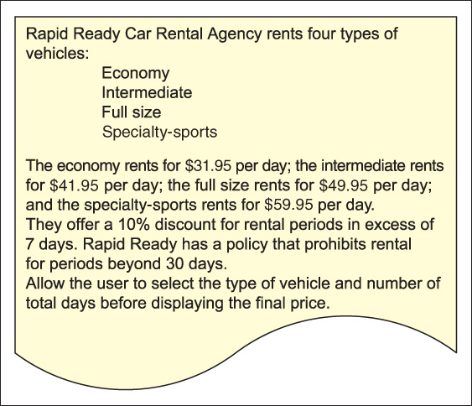
Analyze the Problem (continued)
Figure 1-3 Program specification sheet - car rental agency problem

Slide 16
Analyze the Problem (continued)
What kind of data will be available for input?
What types of values (i.e., whole numbers, alphabetic characters, and numbers with decimal points) will be in each of the identified data items?
What is the domain (range of the values) for each input item?
Will the user of the program be inputting values?
If the problem solution is to be used with multiple data sets, are there any data items that stay the same, or remain constant, with each set?

Slide 17
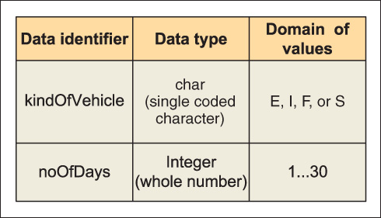
Analyze the Problem (continued)
May help to see sample input for each data item
Figure 1-4 Data for car rental agency

Slide 18
Step 2: Design a Solution
Several approaches
Procedural and object-oriented methodologies
Careful design always leads to better solutions
Divide and Conquer
Break the problem into smaller subtasks
Top-down design, stepwise refinement
Object-oriented approach
Focus is on determining data and methods (behaviors)

Slide 19
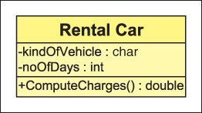
Class Diagram
Figure 1-5 Class diagram of car rental agency

Slide 20
Design
Object-oriented approach
Class diagram
Divided into three sections
Top portion identifies the name of the class
Middle portion lists the data characteristics
Bottom portion shows what actions are to be performed on the data

Slide 21
Design (continued)
Structured procedural approach
Process oriented
Focuses on the processes that data undergoes from input until meaningful output is produced
Tools used
Flowcharts
Pseudocode, structured English
Algorithm written in near English statements for pseudocode

Slide 22
Design a Solution (continued)
Algorithm
Clear, unambiguous, step-by-step process for solving a problem
Steps must be expressed so completely and so precisely that all details are included
Instructions should be simple to perform
Instructions should be carried out in a finite amount of time
Following the steps blindly should result in the same results

Slide 23
Step 3: Code the Solution
After completing the design, verify the algorithm is correct
Translate the algorithm into source code
Follow the rules of the language
Integrated Development Environment (IDE)
Visual Studio
Tools for typing program statements, compiling, executing, and debugging applications

Slide 24
Step 4: Implement the Code
Source code is compiled to check for rule violations
C# → Source code is converted into Microsoft Intermediate Language (IL)
IL is between high-level source code and native code
IL code not directly executable on any computer
IL code not tied to any specific CPU platform
Second step, managed by .NET’s Common Language Runtime (CLR), is required

Slide 25
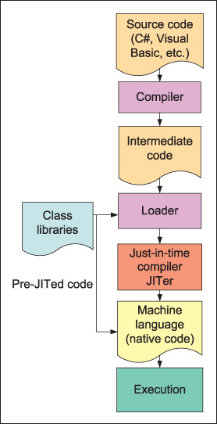
Implement the Code (continued)
CLR loads .NET classes
A second compilation, called a just-in-time (JIT) compilation, is performed
IL code is converted to the platform’s native code
Figure 1-6 Execution
steps for .NET

Slide 26
Step 5: Test and Debug
Test the program to ensure consistent results
Test Driven Development (TDD)
Development methodologies built around testing
Plan your testing
Test plan should include extreme values and possible problem cases
Logic errors
Might cause abnormal termination or incorrect results to be produced
Run-time error is one form of logic error

Slide 27
Programming Methodologies
Structured Procedural Programming
Emerged in the 1970s
Object-Oriented Programming
Newer approach

Slide 28
Structured Procedural Programming
Associated with top-down design
Analogy of building a house
Write each of the subprograms as separate functions or methods invoked by a main controlling function or module
Drawbacks
During software maintenance, programs are more difficult to maintain
Less opportunity to reuse code

Slide 29
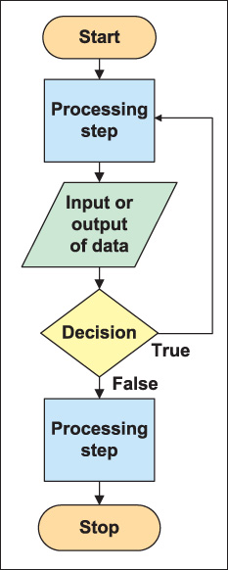
Flowchart
Oval – beginning and end
Rectangular – processes
Diamond – decision to be made
Parallelogram – inputs and output
Flow line
Figure 1-7 Flowchart
symbols and their
interpretation

Slide 30
Pseudocode or Structured English
Tool used to develop an algorithm
Steps written in pseudo or near code format
Combination English statements and the chosen programming language
Verbs like compute, calculate, sum, print, input, display are used
Loops are shown with while or do while
if and if/else used for decisions

Slide 31
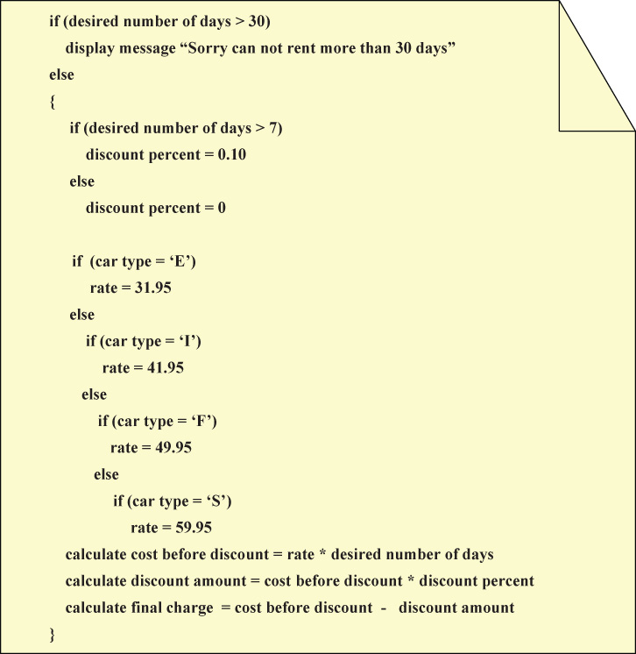
Figure 1-8 Pseudocode or Structured English for Rental Car
application

Slide 32
Object-Oriented Programming
Construct complex systems that model real-world entities
Facilitates designing components
Assumption is that the world contains a number of entities that can be identified and described

Slide 33
Object-Oriented Methodologies
Abstraction
Through abstracting, determine attributes (data) and behaviors (processes on the data) of the entities
Encapsulation
Combine attributes and behaviors to form a class
Polymorphism
Methods of parent and subclasses can have the same name, but offer different functionality
Invoke methods of the same name on objects of different classes and have the correct method executed

Slide 34
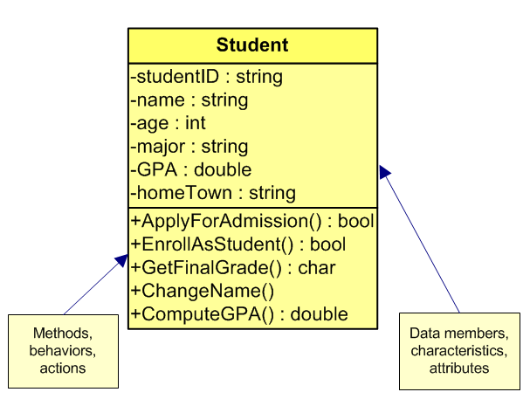
Class Diagram
Figure 1-9 Student class diagram

Slide 35
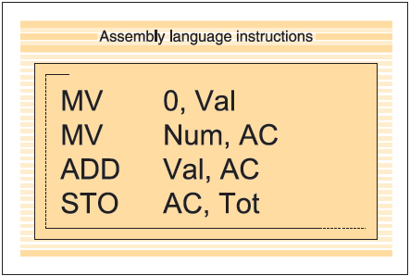
Evolution of C# and .NET
Programming Languages
1940s: Programmers toggled switches on the front of computers
1950s: Assembly languages replaced the binary notation
Figure 1-10 Assembly
language instruction
to add two values

Slide 36
Evolution of C# and .NET (continued)
Late 1950s: High-level languages came into existence
Today: More than 2,000 high-level languages
Noteworthy high-level programming languages are C, C++, Visual Basic, Java, and C#

Slide 37
.NET
Not an operating system
An environment in which programs run
Resides at a layer between operating system and other applications
Offers multi-language independence
One application can be written in more than one language
Includes over 2,500 reusable types (classes)
Enables creation of dynamic Web pages and Web services
Scalable component development

Slide 38
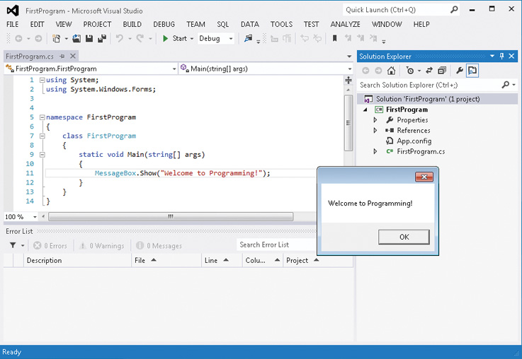
.NET (continued)
Figure 1-11 Visual Studio integrated development environment

Slide 39
Why C#
One of the newer programming languages
Conforms closely to C and C++
Has the rapid graphical user interface (GUI) features of previous versions of Visual Basic
Has the added power of C++
Has the object-oriented class libraries similar to Java

Slide 40
Why C# (continued)
Can be used to develop a number of applications
Software components
Mobile applications
Dynamic Web pages
Database access components
Windows desktop applications
Web services
Console-based applications

Slide 41
C# Relationship to .NET
Many compilers targeting the .NET platform are available
C# was used most heavily for development of the .NET Framework class libraries
C#, in conjunction with the .NET Framework classes, offers an exciting vehicle to incorporate and use emerging Web standards

Slide 42
C# Relationship to .NET (continued)
C# is object-oriented
In 2001, the European Computer Manufacturers Association (ECMA) General Assembly ratified C# and its common language infrastructure (CLI) specifications into international standards

Slide 43
Types of Applications Developed with C#
Web applications
Windows graphical user interface (GUI) applications
Console-based applications
Class libraries and stand-alone components (.dlls), smart device applications, and services can also be created

Slide 44
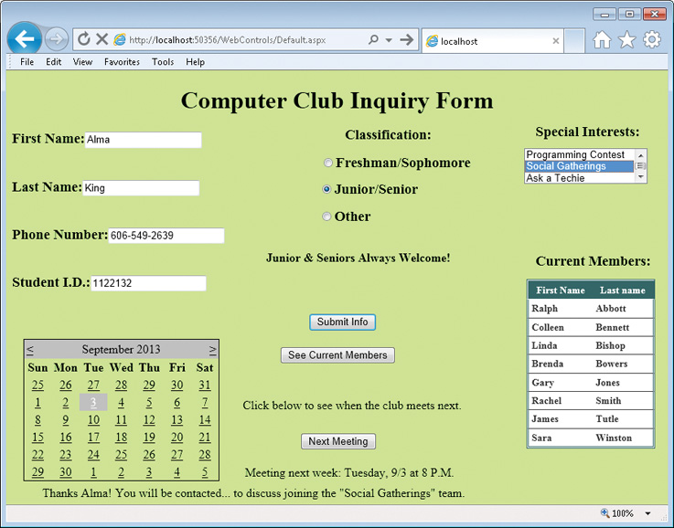
Web Applications
Figure 1-12 Web application written using C#

Slide 45
Web Applications (continued)
C# was designed with the Internet applications in mind
Can quickly build applications that run on the Web with C#
Using Web Forms: part of ASP.NET

Slide 46
Windows Applications
Applications designed for the desktop
Designed for a single platform
Use classes from System.Windows.Form
Applications can include menus, pictures, drop-down controls, buttons, text boxes, and labels
Use drag-and-drop feature of Visual Studio

Slide 47
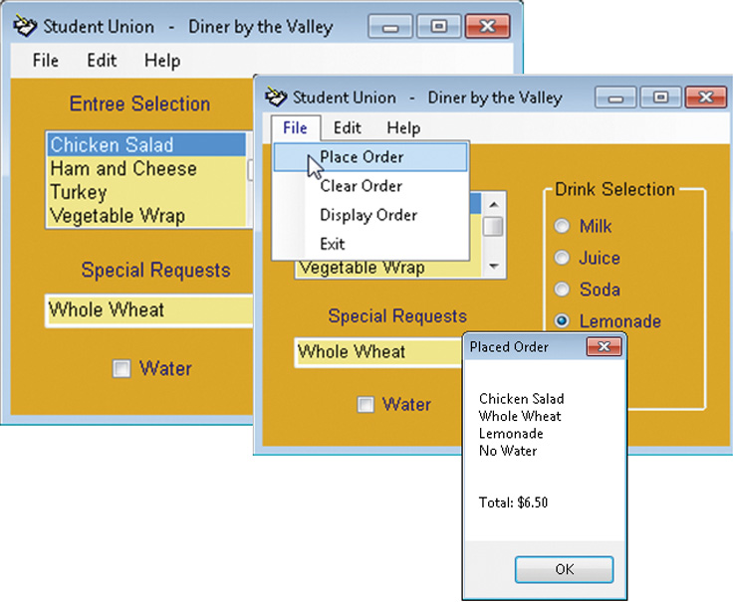
Windows Applications (continued)
Figure 1-13 Windows application written using C#

Slide 48
Console Applications
Normally send requests to the operating system
Display text on the command console
Easiest to create
Simplest approach to learning software development
Minimal overhead for input and output of data

Slide 49
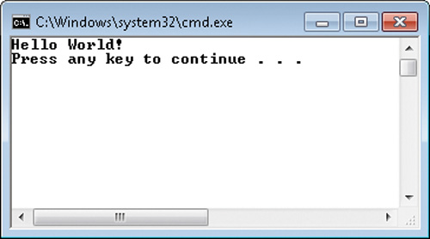
Output from the First C# Program
Console-based application output
Figure 1-14 Output from Example 1-1 console application

Slide 50
Exploring the First C# Program
From Example 1-1
line 1 // This is traditionally the first program written.
line 2 using System;
line 3 namespace HelloWorldProgram
line 4 {
line 5 class HelloWorld
line 6 {
line 7 static void Main( )
line 8 {
line 9 Console.WriteLine("Hello World!");
line 10 }
line 11 }
line 12 }
Comments in green
Keywords in blue

Slide 51
Elements of a C# Program
Comments
line 1 // This is traditionally the first program written.
Like making a note to yourself or readers of your program
Not considered instructions to the computer
Not checked for rule violations
Document what the program statements are doing

Slide 52
Comments
Make the code more readable
Three types of commenting syntax
Inline comments
Multiline comments
XML documentation comments

Slide 53
Inline Comments
Indicated by two forward slashes (//)
Considered a one-line comment
Everything to the right of the slashes ignored by the compiler
Carriage return (Enter) ends the comment
// This is traditionally the first program written.

Slide 54
Multiline Comment
Forward slash followed by an asterisk (/*) marks the beginning
Opposite pattern (*/) marks the end
Also called block comments
/* This is the beginning of a block multiline comment. It can go on for several lines or just be on a single line. No additional symbols are needed after the beginning two characters. Notice there is no space placed between the two characters. To end the comment, use the following symbols.
*/

Slide 55
XML Documentation Comments
Extensible Markup Language (XML)
Markup language that provides a format for describing data using tags
Similar to HTML tags
Three forward slashes (///) mark beginning
Advanced documentation technique used for XML-style comments
Compiler generates XML documentation from them

Slide 56
using Directive
Permits use of classes found in specific namespaces without having to qualify them
Framework class library
Over 2,000 classes included
Syntax
using namespaceIdentifier;

Slide 57
Namespace
Namespaces provide scope for the names defined within the group
Captain example
Groups semantically related types under a single umbrella
System: most important and frequently used namespace
Can define your own namespace
Each namespace enclosed in curly braces: { }

Slide 58
Namespace (continued)
Predefined namespace (System) – part of .NET FCL
From Example 1-1
line 1 // This is traditionally the first program written.
line 2 using System;
line 3 namespace HelloWorldProgram
line 4 {
line 12 }
User-defined namespace
Body of user-defined namespace

Slide 59
Class Definition
Building block of object-oriented program
Everything in C# is designed around a class
Every program must have at least one class
Classes define a category, or type, of object
Every class is named

Slide 60
Class Definition (continued)
line 1 // This is traditionally the first program written.
line 2 using System;
line 3 namespace HelloWorldProgram
line 4 {
line 5 class HelloWorld
line 6 {
line 11 }
line 12 }
User-defined class

Slide 61
Class Definition (continued)
Define class members within curly braces
Include data members
Stores values associated with the state of the class
Include method members
Performs some behavior of the class
Can call predefined classes’ methods
Main( )

Slide 62
Main( ) Method
“Entry point” for all applications
Where the program begins execution
Execution ends after last statement in Main( )
Can be placed anywhere inside the class definition
Applications must have one Main( ) method
Begins with uppercase character

Slide 63
Main( ) Method Heading
line 7 static void Main( )
Begins with the keyword static
Second keyword → return type
void signifies no value returned
Name of the method
Main is the name of Main( ) method
Parentheses “( )” used for arguments
No arguments for Main( ) – empty parentheses

Slide 64
Method Body − Statements
Enclosed in curly braces
Example Main( ) method body
line 7 static void Main( )
line 8 {
line 9 Console.WriteLine("Hello World!");
line 10 }
Includes program statements
Calls to other method
Here Main( ) calling WriteLine( ) method

Slide 65
Method Calls
line 9 Console.WriteLine("Hello World!");
Program statements
WriteLine( ) → member of the Console class
Main( ) invoking WriteLine( ) method
Member of Console class
Method call ends in semicolon

Slide 66
Program Statements
Write ( ) → Member of Console class
Argument(s) enclosed in double quotes inside ( )
"Hello World!" is the method’s argument
"Hello World!" is string argument
String of characters
May be called with or without arguments
Console.WriteLine( );
Console.WriteLine("WriteLine( ) is a method.");
Console.Write("Main( ) is a method.");

Slide 67
Program Statements (continued)
Read( ) and ReadKey( ) accept one character from the input device
ReadLine( ) accepts string of characters
Until the enter key is pressed
Write( ) does not automatically advance to next line
Write("An example\n");
Same as WriteLine("An example");
Includes special escape sequences

Slide 68
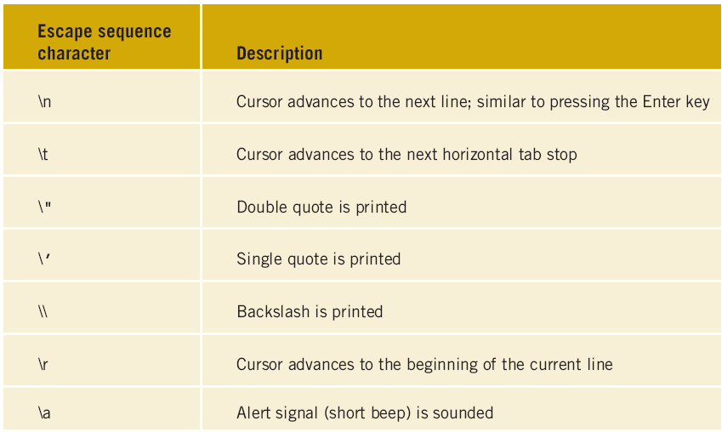
Escape Sequence Characters
Table 1-1 Escape sequences

Slide 69
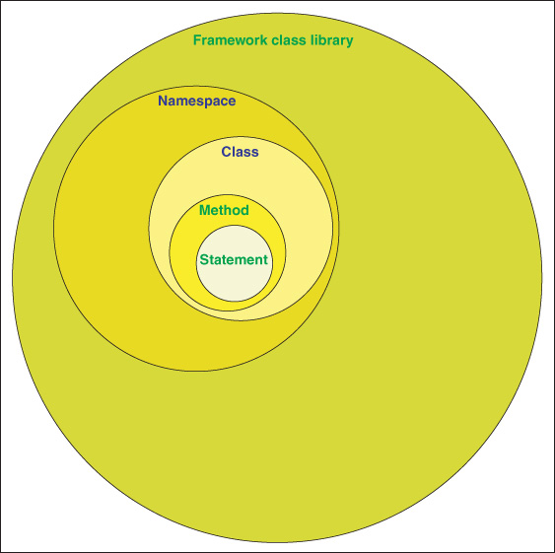
C# Elements
Figure 1-15 Relationship among C# elements

Slide 70
Create Console Application
Begin by opening Visual Studio
Create new project
Select New Project on the Start page
OR use File → New Project option

Slide 71
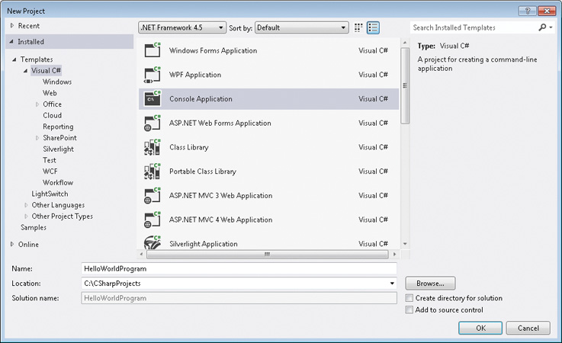
Create New Project
Figure 1-16 Creating a console application

Slide 72
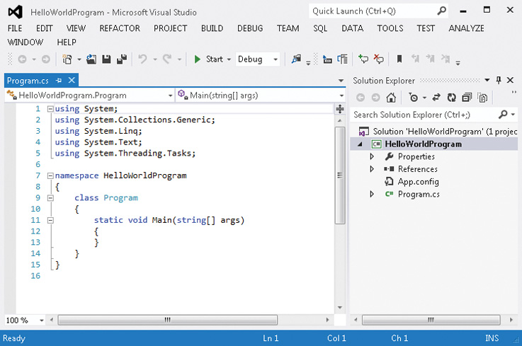
Code Automatically Generated
Figure 1-17 Code automatically generated by Visual Studio

Slide 73
Typing Your Program Statements
IntelliSense feature of the IDE
Change the name of the class and the source code filename
Use the Solution Explorer Window to change the source code filename
Select View → Solution Explorer

Slide 74
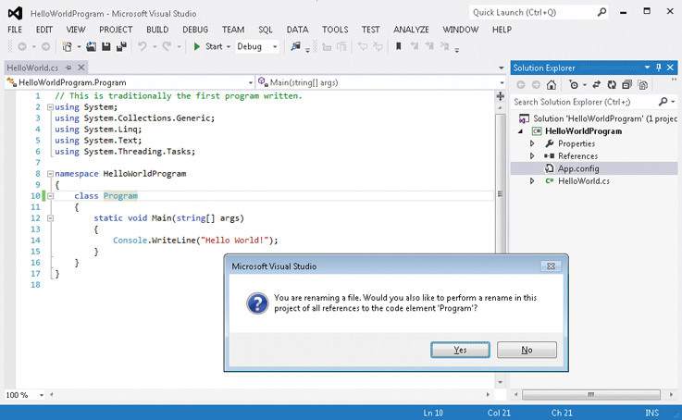
Rename Source Code Name
Clicking Yes causes the class name to also be renamed
Figure 1-18 Changing the source code name from Program

Slide 75
Compile and Run Application
To Compile – click Build on the Build menu
To run or execute application – click Start or Start Without Debugging on the Debug menu
Shortcut – if executing code that has not been compiled, automatically compiles first
Start option does not hold output screen → output flashes quickly
Last statement in Main( ), could add Console.Read( ); or ReadKey( );

Slide 76
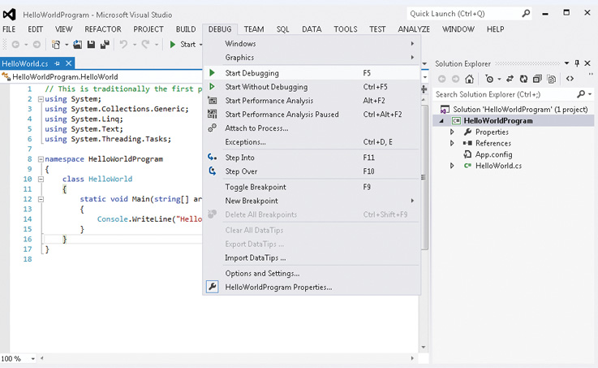
Build Visual Studio Project
Figure 1-19 Execution of an application using Visual Studio

Slide 77
Debugging an Application
Types of errors
Syntax errors
Typing error
Misspelled name
Forget to end a statement with a semicolon
Run-time errors
Failing to fully understand the problem
More difficult to detect

Slide 78
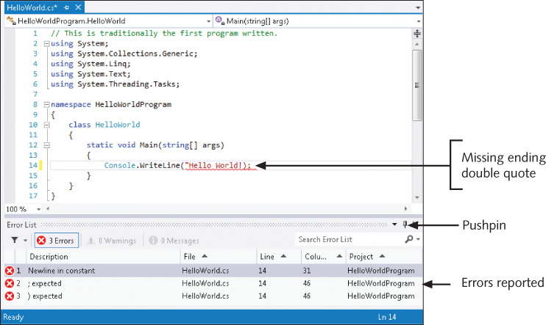
Error Listing
Figure 1-20 Syntax error message listing

Slide 79
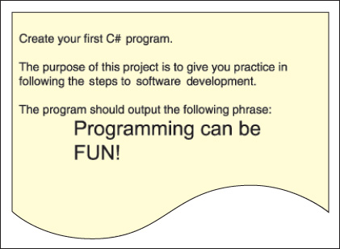
Creating an Application – ProgrammingMessage Example
Figure 1-21 Problem specification sheet for the
ProgrammingMessage example

Slide 80
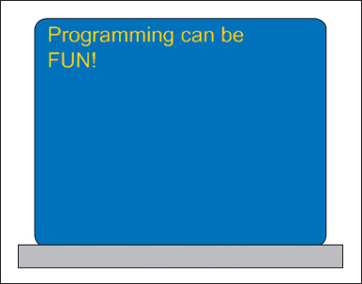
ProgrammingMessage Example
Figure 1-22 Prototype for the ProgrammingMessage example

Slide 81
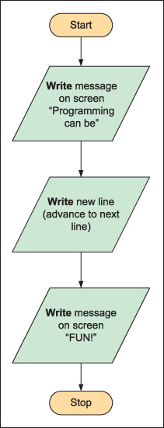
ProgrammingMessage Example
Pseudocode would include a single line to display the message "Programming can be FUN!" on the output screen
Figure 1-23 Algorithm for
ProgrammingMessage example

Slide 82
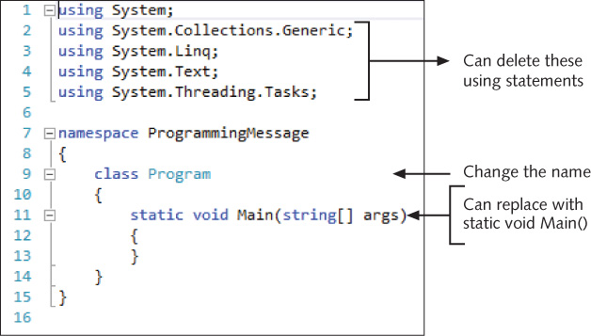
ProgrammingMessage Example
Depending on your current settings, you may not need to make some of these changes
Figure 1-24 Recommended
deletions

Slide 83
ProgrammingMessage Example
/* Programmer: [supply your name]
*/
using System;
namespace ProgrammingMessage
{
class ProgrammingMessage
{
static void Main( )
{
Console.WriteLine("Programming can be");
Console.WriteLine("FUN! ");
Console.ReadKey( );
}
}
}
Complete program listing

Slide 84
Coding Standards
Following standards leads to better solutions
Following standards makes your code more maintainable
Following standards saves you time when you go to modify your solution
Developing standards that you consistently adhere to increases your coding efficiency

Slide 85
Coding Standards - Pseudocode Suggestions
Use action verbs to imply what type of activities should be performed
Group items and add indentation to imply they belong together
Use keywords like while or do while to imply looping
Use if or if/else for testing the contents of memory locations

Slide 86
Resources
C# Language Specifications – http://www.microsoft.com/en-us/download/details.aspx?id=7029
Visual C# Express download – http://www.microsoft.com/visualstudio/en-us/products/2010-editions/visual-csharp-express
The MSDN Visual C# home page – http://msdn2.microsoft.com/en-us/vcsharp/default.aspx

Slide 87
Chapter Summary
Types of applications developed with C#
Web applications
Windows graphical user interface (GUI) applications
Console-based applications
Framework class library groups by namespaces
Namespaces group classes
Classes have methods
Methods include program statements

Slide 88
Chapter Summary (continued)
Programming methodologies
Structured procedural
Object-oriented
C#
One of the .NET managed programming languages
Object-oriented
2001 EMCA standardized
Provides rapid GUI development of Visual Basic
Provides number crunching power of C++
Provides large library of classes similar to Java

Slide 89
Chapter Summary (continued)
Visual Studio includes .NET Framework
Editor tool, compiler, debugger, and executor
Compile using Build
Run using Start or Start without Debugging
Debugging
Syntax errors
Run-time errors
Use five steps of program development to create applications

